Slide 1
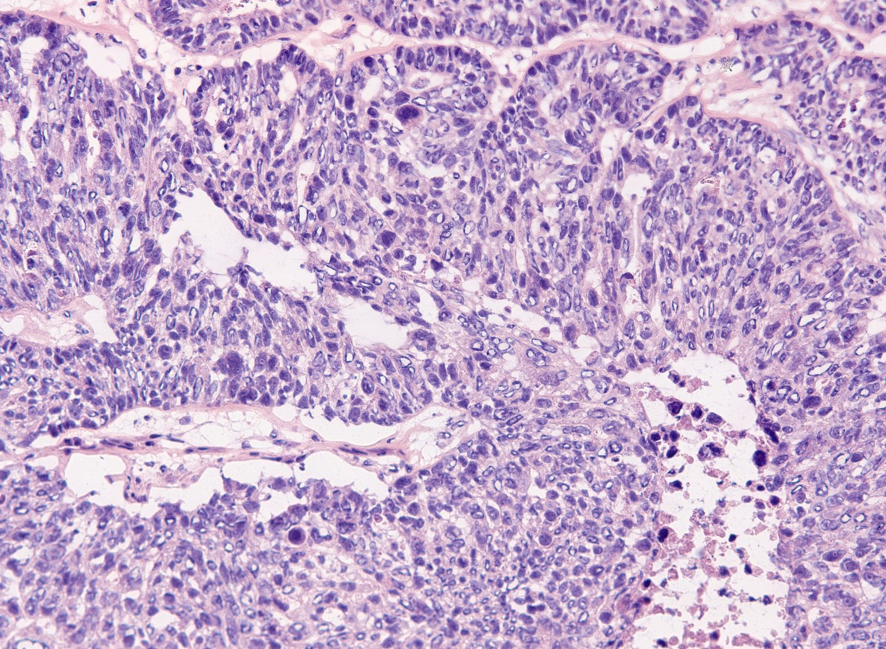
Evaluating the Accuracy of a Predictive Cancer Test
Notes:
Roberto
Intro of team
Who did what

Slide 2
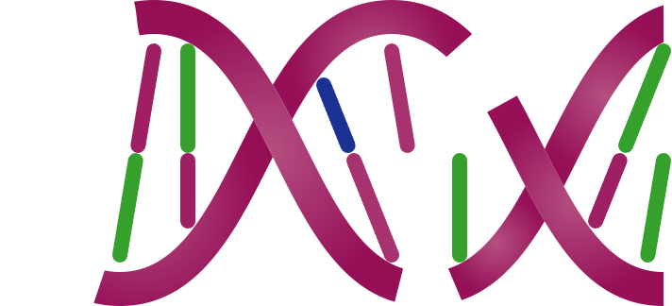
Many Ovarian Cancers Develop Genomic Instability
Genomic Instability is a feature of certain cancers and is caused by defective DNA repair, for example when the BRCA genes stop functioning
Why Measure Genomic Instability
A new class of drug is very effective at killing cancer cells that have Genomic Instability, but it is not toxic to normal cells.
Genomic Instability is now an important biomarker predicting benefit from these drugs. Patients whose tumors lack Genomic Instability will not benefit.
When BRCA1 or BRCA2 is lost, double strand breaks don’t get repaired properly
Notes:
Roberto
Description of problem
The purpose of this project is to create a tool that can help pathologists predict which biopsy samples tested by a neural network-based diagnostic test are likely to have received a false positive or a false negative result, thereby increasing the diagnostic efficacy of the test.
The Peter MacCallum Cancer Centre uses a test from SOPHIA Genetics to test biopsy samples to determine whether patients with ovarian cancer will respond to a particular drug therapy. The test looks for ‘genomic instability’, which is where there are multiple breaks in the DNA sequence. If this feature (or 'phenotype') is seen in ovarian cancer genomes, it is a positive predictive biomarker for treatment with new drugs (i.e. such patients are likely to do better than if treated with standard drugs).
BRCA1 and BRCA2 are genes that encode proteins that help repair damaged DNA. Everyone has two copies of each of these genes—one copy inherited from each parent. BRCA1 and BRCA2 are called tumor suppressor genes because when they stop functioning, usually due to harmful (or pathogenic) variants (or mutations), tumours may develop.
Some people have a genetic predisposition to ovarian (and breast) cancer because they have already inherited a pathogenic BRCA1 or BRCA2 variant from one parent. Although they would have also inherited a normal copy of that gene from the other parent (because embryos inheriting two harmful variants cannot develop), the normal copy can be lost or changed in some cells in the body during the person’s lifetime. Cells that lose their remaining functioning BRCA1 or BRCA2 genes can grow out of control and become cancer.
In ovarian cancer, the cancerous cells will often have multiple breaks in their DNA (genetic instability) because BRCA1 or BRCA2 is no longer functional. Patients with this 'phenotype' are likely to respond well to a particular drug therapy that inhibits backup DNA repair processes, resulting in cancer cell death. This drug is prescribed once a patient is in remission and helps control future tumor growth. The drug has the advantage of having fewer side-effects than other cancer treatments available.
The ’gold standard’ test for genetic instability is the Myriad Genetics myChoice test; however, this is not available in Australia. An alternative, the SOPHIA Genetics test, uses a machine learning model trained to detect genomic instability within cancer genome. This model has high accuracy compared to Myriad (approximately 95%) however, false negatives and false positives remain an issue and have serious consequences for the patients – whether being prescribed a drug that is ineffective (false positive) or not receiving a drug when it is suitable (false negative). The idea is
We have been supplied training data from the Peter MacCallum Cancer Centre. This is a series of test results from 135 cases, with corresponding Myriad and SOPHIA results. The data includes many independent variables for training a model.
Two approaches have been taken: development of a neural network using TensorFlow, creating a binary classification model that can predict which SOPHIA genomic instability results may be misclassifications; alternatively, given the limited number of results and the high risk of a neural network becoming overfitted, a Random Forest model to achieve the same prediction.

Slide 3
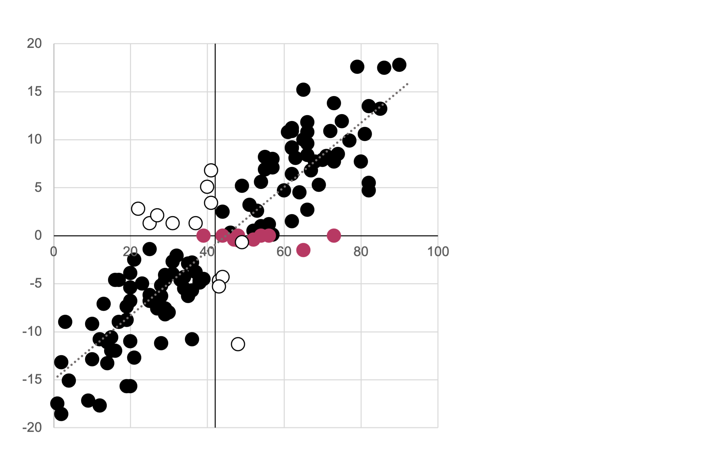
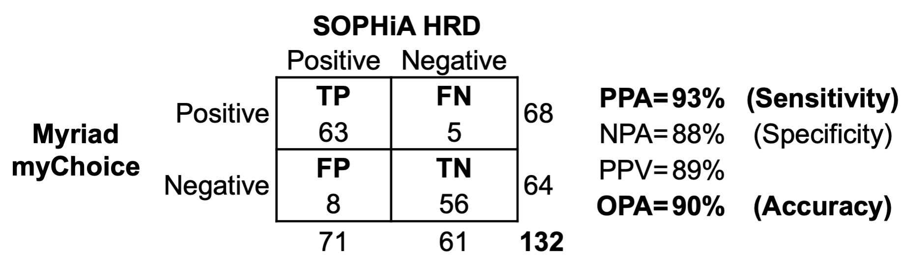
Tests that measure Genomic Instability are not 100% accurate
We compared a Genomic Instability test from SOPHiA Genetics with a reference test from Myriad Genetics
SOPHiA Genetics agreed with Myriad Genetics only 93% of the time
SOPHiA GI Index
Myriad GI Score
Notes:
Richard T
Background to tests

Slide 4
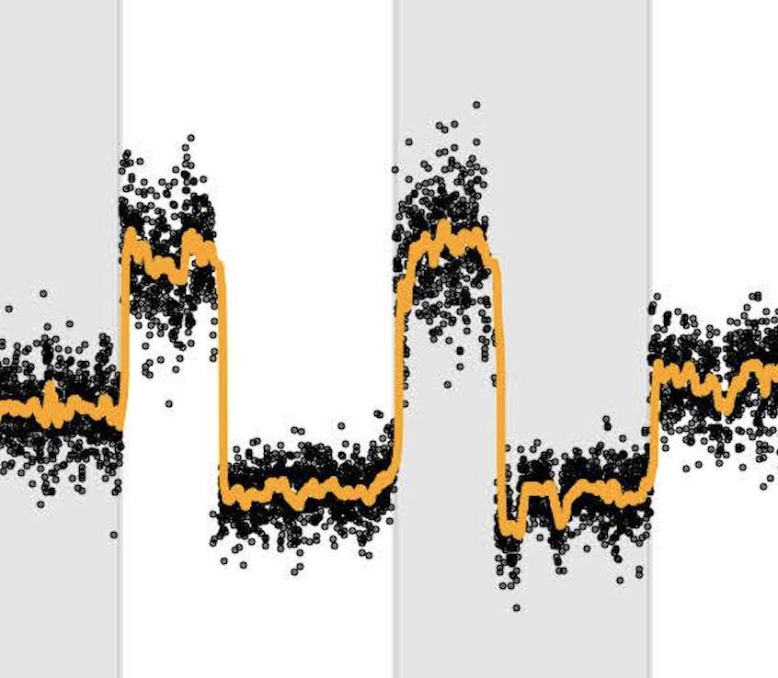
We asked, what characteristics of a test or sample is associated with disagreement?
Can we predict if a result generated by SOPHiA Genetics is at risk of being false without performing the Myriad Genetics reference test?
Each Myriad Genetics test generates several features that can be used to train a model that would help us accept or reject the cancer test result.
Normalized WGS coverage plot
Smoothed WGS coverage plot
The agreement, or lack of, between both tests, performed on our series of 139 ovarian cancer samples, can be used as the target for training our models.
Signal-Noise Ratio
Residual Noise
Signal
Purity-Ploidy Ratio
Notes:
Richard T

Slide 5

Methodology
Collect
Cleanse
Transform
Train
Predict
Data stored in .csv, .xlsx and .pdf file formats merged into a single .csv file using python scripts and loaded into MongoDB.
We prepared the data for training by dropping redundant columns, ensuring only numerical and categorical values and imputing missing values.
We transformed the data for machine learning by employing one-hot encoding and StandardScalar transformation
We employed two machine learning approaches.
TensorFlow local neural network employing PCA and kerastuner optimisation.
SciKitLearn random forest employing cross-validation training
We applied our models to an independent set of test results.
Notes:
Richard S

Slide 6
Database
Peter MacCallum
Data Set
Processing – scaling and PCA
Report, Presentation
Mongo DB
Self auditing output
Modelling NN and Random Forest
Mongo DB – used to store records.
Advantage:
Flexible regarding input files (CSV, JSON),
No formal schema - flexible as to structure and inputs as project evolved.
Hyperparameter tuning
Notes:
Richard S
Why we used Mongo
Script to translate data from nested structure to allow querying
Self auditing

Slide 7
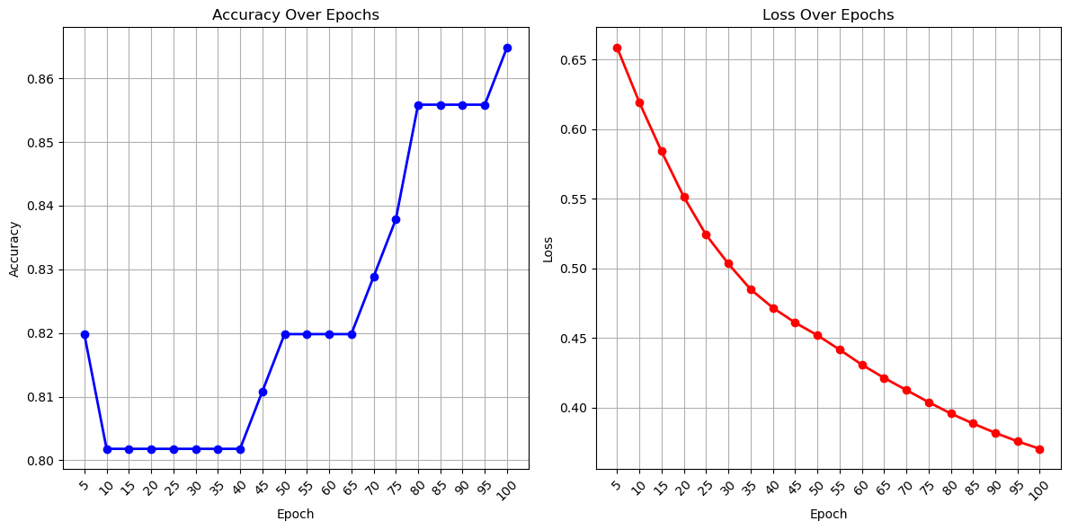
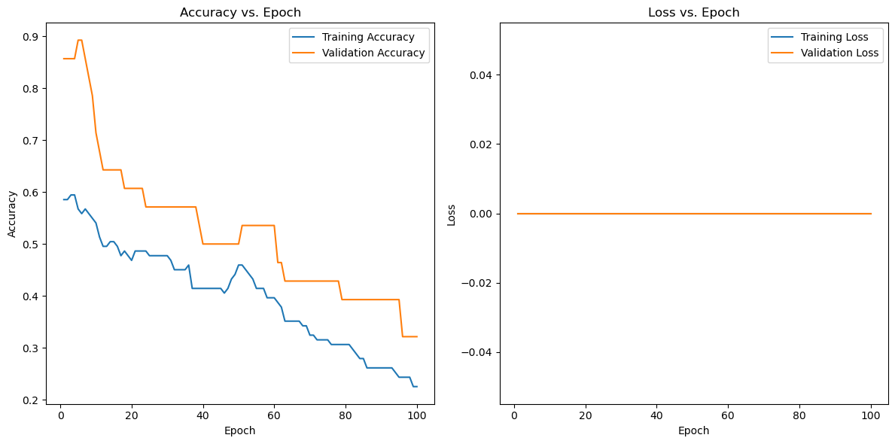
Neural Network Model
Our neural network was trained over epochs (generations) to maximise utility with respect to loss and accuracy.
Due to the spread of data in our limited predictive data set, the PCA model was adopted. This ensured that the dimensionality of training and predictive data would be equal and ensure the use of our model.
The kerastuner optimised the Hyperparameters which could easily be retrieved with a MongoDB call
Notes:
Richard S

Slide 8
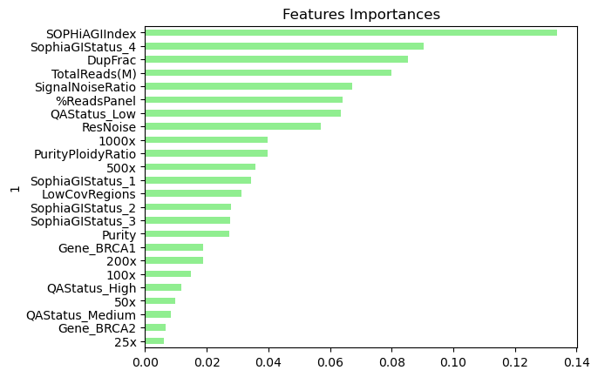
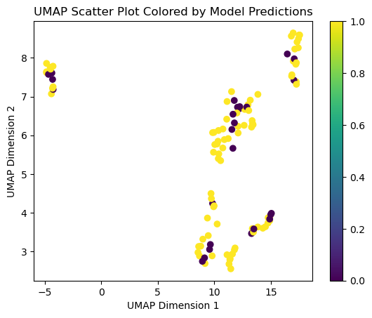
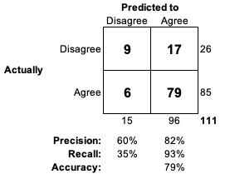
Random Forest Model
Random forest algorithm with cross-validation.
Advantages:
Better interpretability
Less likelihood of overfitting compared to neural network algorithms
Good at predicting correct test results
Poor at predicting incorrect test results
Using domain knowledge, we think minor features may be skewing this model.
Unsupervised learning using UMAP algorithm shows disagreement occurs throughout the data space
Notes:
Andrew F

Slide 9
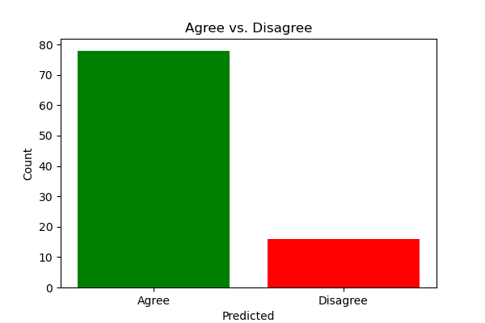
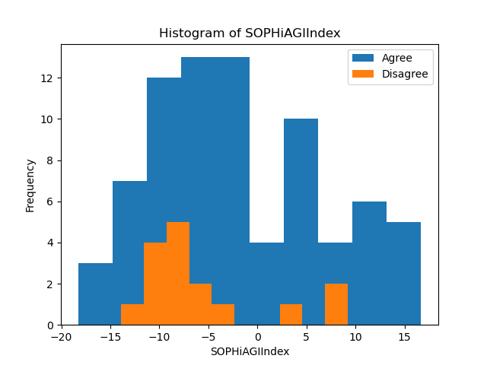
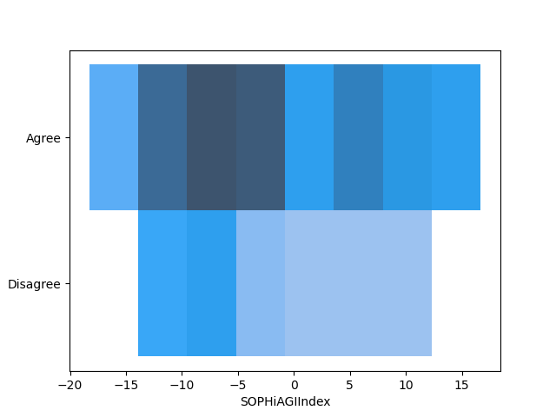
Random Forest predicted all results to be correct
Training Results and Predictions
We asked the models to predict if the SOPHiA test results were likely to be correct or incorrect.
We observe more predicted incorrect results with NN model compared to RF
On the right, we can visualise disagreement / agreement by our models on our training data using different plots:
Agree v Disagree
Stacked Histogram binned by SOPHiA GI result
Colour intensity representing count of samples
This shows –ve SOPHiA results are more likely to disagree – FN risk
Notes:
Andrew F

Slide 10
Lessons learned and suggestions for Improvement
There are proven use cases where quality control of complex diagnostic test results is performed by machine learning.
Our neural network approach has potential but requires
larger training set
augmentation techniques
audit of input features
Our random forest approach lacked accuracy but is more explainable than the neural network model suggesting use of
logistic regression
support vector model
Notes:
Andrew F

Slide 11

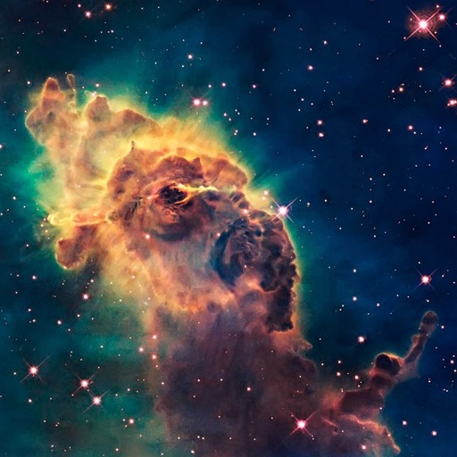


Thank you for listening We are: Andrew Fellowes Roberto Sammassimo Richard Soos Richard Thornton We are glad its over

Slide 12
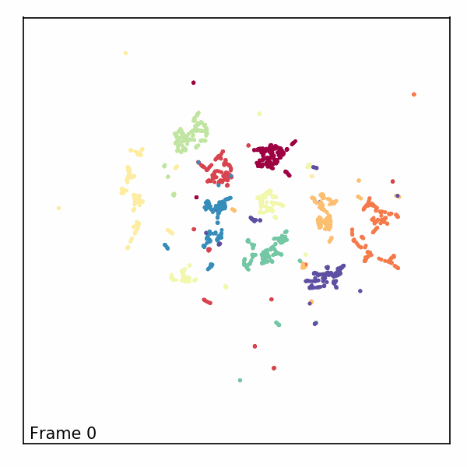
UMAP (Uniform Manifold Approximation and Projection)
https://github.com/lmcinnes/umap
UMAP is a fast general purpose dimension reduction algorithm like PCA that can handle large, high dimensional and sparse datasets.

